Slide 1
Towards Building a Frame-Based Ontology for the Arabic Language
Mariam Biltawi, Sara Tedmori, Arafat Awajan

Slide 2
Agenda
Introduction
Part I: Lexical Semantics
Part II: Related work
Part III: Proposed Framework
Conclusion

Slide 3
introduction
Natural Language Understanding NLU: is a subtask of Natural Language Processing
NLU focuses on analyzing the semantic features present in a text such as concepts, entities, keywords, relations, emotions, categories and much more, with the anticipation of gaining a full understanding of the meaning conveyed in the text.

Slide 4
introduction
Semantics refer to the study of the meanings of words and phrases in language and can be applied to:
Single words (aka lexical semantics):
Entire texts (aka compositional semantics):

Slide 5
introduction
Lexical semantics are concerned with the meanings of individual words and with the meaning/semantic relationships that individual words have with one another.
Compositional semantics are concerned with the meaning of the sentence or larger unit which goes beyond simply combining the meaning of the individual lexical words/units.

Slide 6
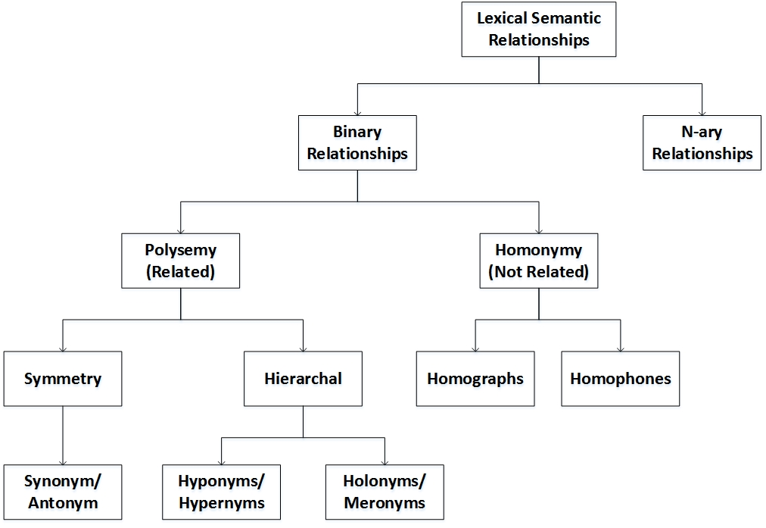

Slide 7
Part I: Lexical Semantics

Slide 8
Symmetric Relationships
Synonyms refers to words that have different pronunciation but share the same meaning (e.g sit / جلس – قعد)
Antonymy refers to word pairs sharing opposite meanings (e.g hot and cold / ساخن وبارد).

Slide 9
Hierarchal Relationships
Hyponymy refers to the relationship between a general word (aka hypernyms) and specific instances of it (aka hyponyms). For example, (cats and dogs / القطط و الكلاب) are hyponyms of the hypernym word (animals / حيوانات).
Holonym refers to a word that denotes a whole of another word namely meronym which in turn is a part of the holonym. For example: the meronym (عجل / wheel) is a part of the holonym (سيارة / car).

Slide 10
Homonymy
Homographs refer to words that have different meanings but share the same spelling.
Homophones refer to words that also have different meanings but are pronounced the same.
Only examples of homographs can be found in the Arabic language as Arabic language is highly phonetic, i.e.: the writing reflects the pronunciation. For example, the word (ذهب) is a homograph word because it has two meanings either ‘went’ or ‘gold’ and one spelling.

Slide 11
Example of resources that provide Binary lexical Relationships between words
WordNet for English Language.
Arabic WordNet, a WordNet for Arabic language.

Slide 12
N-ary Relationships
Semantic fields is a set of words that have related meaning to specific object or namely a frame.
These semantic fields represent n-ary relations with the frame that they refer to through capturing more relationships among entire sets of words from a single domain.
Example:
the words: University / جامعه, Lecturer / محاضر, Student / طالب, Hall / قاعة, Library / مكتبة, Lab / مختبر, Section / شعبة, Course / مادة, Registration / تسجيل,
Are all related to the frame University Education / تعليم جامعي.

Slide 13
Lexical semantics
Lexical semantics are realizable after successfully completing some/all of following subtasks:
Word sense disambiguation,
Semantic role labeling,
Multiword expression composition/decomposition,
Ontology learning and population, and
Semantic language modelling.

Slide 14
Part II: Related work

Slide 15
Ontology
Ontology is a technical term used to describe concepts, properties and relations among concepts in order to represent models of knowledge or discourse.
It can represent meta-data schema for a knowledge of different applications in the form of vocabulary of concepts, and it can be shared by humans and machines.

Slide 16
ontology
Ontologies can be built either
from unstructured text, or
through exploiting directories of web documents, or
through integrating existing resources.
There are no research papers found that aims to build ontologies through integrating existing resources due to the lack of freely available resources.

Slide 17
Related Work
Although a number of attempts have been made to build ontologies for the Arabic language, only one resource, Arabic WordNet, which provides a lexical ontology for the Arabic language is freely available.

Slide 18
Part III: Proposed Framework

Slide 19
Main Idea
Is to provide machines with ontologies built from picture dictionaries, imitating the idea that children learn from such dictionaries in their early ages, and they are provided with the basic terms related to the world.

Slide 20
Proposed Framework
The proposed ontology learning and population framework consists of two main phases.
Phase I: Manual Construction of the Frame-based Ontology.
Phase II: Frame-based Ontology Population.

Slide 21
Phase I: Manual Construction of the Frame-based Ontology.
Data collection
66 frames were collected from three English picture dictionaries
each frame have multiple terms/semantic fields related to it.

Slide 22
Phase I: Manual Construction of the Frame-based Ontology.
Data collection
Grouping
frames having relations with each other were grouped together to form one super frame

Slide 23
Phase I: Manual Construction of the Frame-based Ontology.
Data collection
Grouping
Removing, adding and translating into Arabic
the 66 frames with their related lexical fields will be translated and those fields that have unrelated meanings will be eliminated, while some other important fields will be added.
“cousin” in the frame “family” represents different meanings in the Arabic language, a female or a male cousin either from the father’s side or from the mother’s side, therefore all these meanings need to be listed.
“part” under the frame “human head”, is considered not an important word and has no significant translation into Arabic related frame “human head”.

Slide 24
Phase I: Manual Construction of the Frame-based Ontology.
Data collection
Grouping
Removing, adding and translating into Arabic
relations between these frames will be built manually in order to prepare the data in a hierarchal form which constitutes a frame and lexical fields below each frame, thus creating the frame-based ontology.
Hierarchal preparation

Slide 25
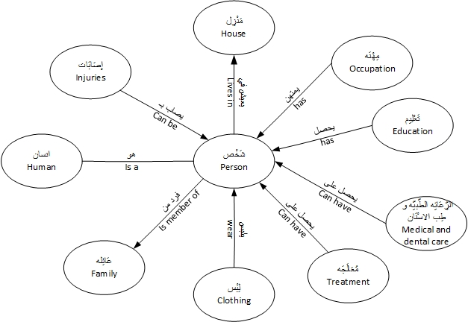
Phase I: Manual Construction of the Frame-based Ontology.

Slide 26
Phase II: Frame-based Ontology Population.
Data collection
Grouping
Removing, adding and translating into Arabic
Applied through looking up for each frame of the frame-based ontology in the WordNet.
If a match is found, then all its related terms and relations will be brought and the ontology is populated.
The resulted ontology will represent a tree, where nodes represent frames and edges represents relationships.
Term lookup and enrichment
Hierarchal preparation

Slide 27
Phase II: Frame-based Ontology Population.
For the frame “Person / شَخص” a number of senses will be brought from the WordNet. Such as (شَخْص ، شَخْص مَا، أَحَد ما، فَرْد، نَفسْ، رُوح، إنسان، اِمْرُؤ، مَرء), where all of them could represent synonyms except (نَفسْ، رُوح) which means soul, and can represent a part of “person”.
The frame “Person” will be modified according to the new data received, noting that the replicated words will be neglected such as the senses (Person / شَخْص, Human / إنسان).

Slide 28
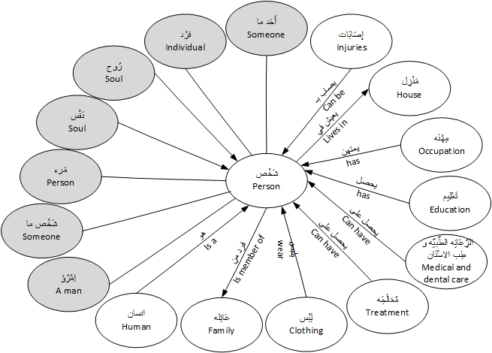
Phase II: Frame-based Ontology Population.

Slide 29
Conclusion and future work
A comprehensive introduction to lexical semantics was presented providing examples from the Arabic language.
Related works of researchers aiming to build ontologies for the Arabic language was presented.
The main objective was to propose a framework for building Arabic frame-based ontology.
As a future work, an effort will be done to implement this work and conduct the experimental results.

Slide 30
Questions

Slide 31
Thank You

